Slide 1
NYC Inspection Analysis
Exploring Restaurant Inspection Trends
Notes:
kat

Slide 2




Get to Know the Team
Katherin Velazquez
Teresa Mei
Wesley Guan
Nicholas Chavez
she/they
she/her
he/him
he/him
Notes:
everyone

Slide 3
Agenda
Introductions
Get to know the data
Client
Executive Summary
Context
Methodology
Team Findings
Conclusions
Notes:
Teresa

Slide 4
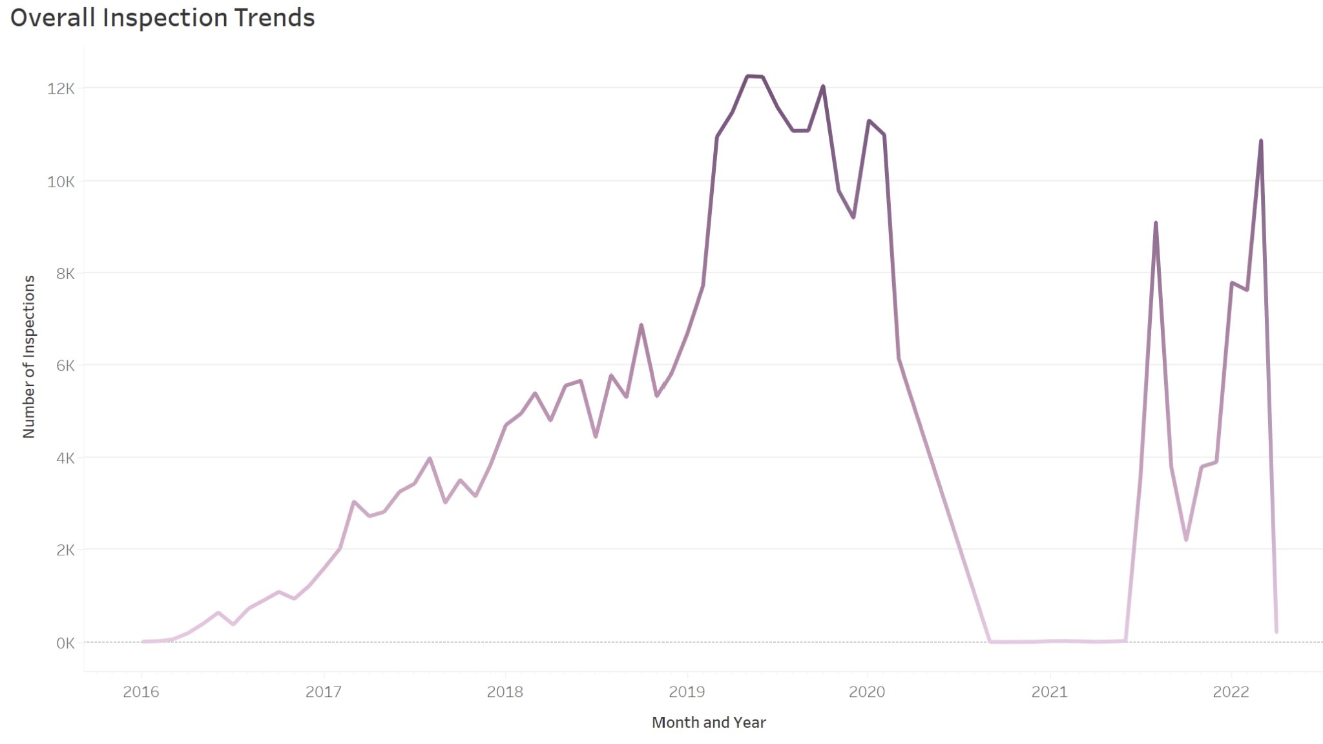
Get to Know the Data
DBA (Doing Business As): Restaurant name
Boro: Borough in which restaurant is located in
Inspection Date: Date of inspection
Violation Code: The code associated with the violation
Violation Description: Description of violation
Score: Total score for a particular inspection
Inspection Type: Inspection program and the type of inspection performed
Grade Score: Density of Grades Held
Notes:
Nick

Slide 5

Client
Client: NYC community and committee members keeping up policy
Need: They need to know their food they are eating
Goal: To have food safety known to community members
Questions
Do certain zipcodes have worse average grades?
Are inspection cycles improving over time?
What are the types of violations?
Photo Credit: NYT
Notes:
Kat
Client:
-NYC as its own entities and the community getting to know their food
-NYC committee members that keep up policy
-The goal is to have food safety known to community members
Questions we answer are:
Do certain zipcodes have worse average grades?
Are inspection cycles improving over time?
What are the types of violations?

Slide 6
Executive Summary
Findings
Investigate
Recommendations
There are a lot of surface equipment issues
Post pandemic scores began to avg higher than pre pandemic
Recommend to further investigate areas that have a lower scoring to support them in what they need
Creating grants for cleaning equipment and hygiene training for lower scoring restaurants
https://www.nyc.gov/site/fund/initiatives/restaurant-revitalization-program.page
Notes:
Wesley 1) recs since there r equipment issues

Slide 7
Context
As the restaurant industry continues to grow, New Yorkers should know where they should spend their money.
https://www.icsc.com/news-and-views/icsc-exchange/new-yorkers-eat-out-130-percent-more-than-other-americans-report
Notes:
Teresa - Everyone wants to eat at a clean and safe restaurant. Especially for New Yorkers, they eat out 130% more than other Americans. As the restaurant industry is expected to grow (albeit moderately), people should also expect food quality to improve. We want to help New Yorkers understand where it's safe and clean to eat, and also help restaurants that might have violations improve. To do that we have to first understand the restaurant inspection results and what they mean. We also want to promote funding for programs that improve quality and help local economies flourish.

Slide 8
Methodology
Cleaning (Excel, SQL)-> Processing (Excel,SQL) -> Visualization (Tableau)
Removed Personality Identified information, such as phone numbers and specific addresses
Developed new metrics to assess quality of restaurants in areas (Grade Score)
Research historical trends aligned with inspection trends
Notes:
nicholas

Slide 9
Findings
Getting to know our Data
Notes:
Wesley

Slide 10
How many restaurant violations are amongst the boroughs of NYC?
Notes:
Wesley

Slide 11
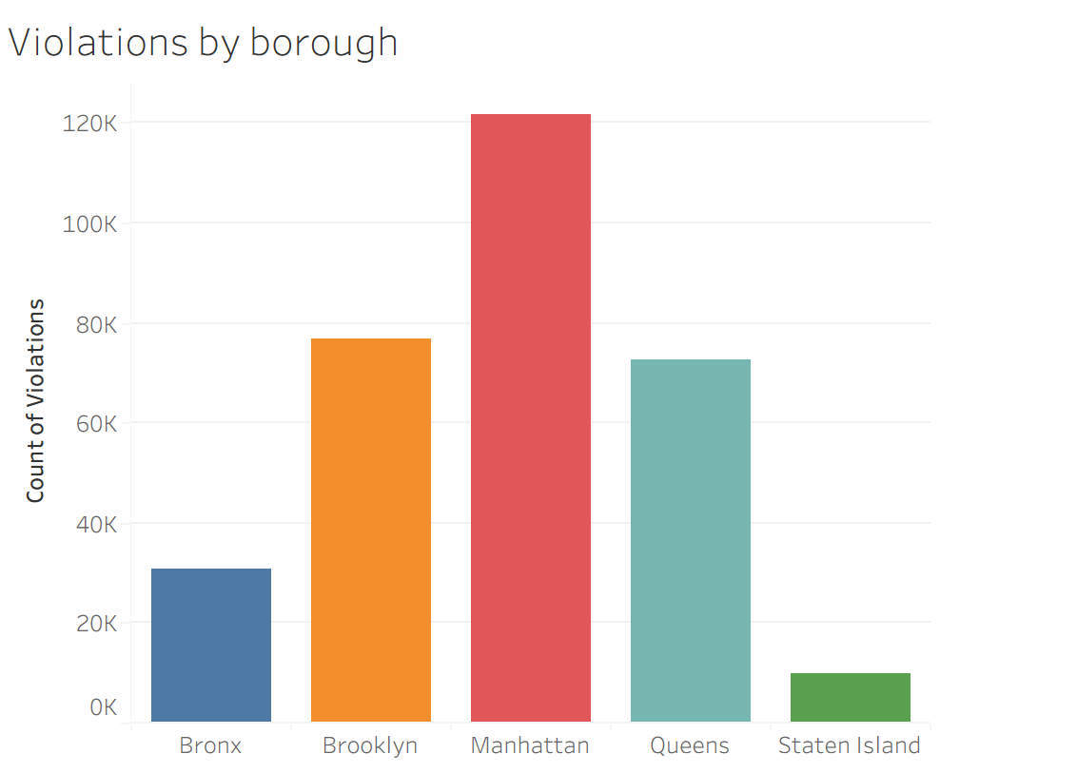
Bronx: 30,823
Brooklyn: 76,847
Manhattan: 121,694
Queens: 72,785
Staten Island: 10,008
Notes:
Wesley 1)Data suggests that inspections are inflated in Manhattan due to restaurant density rather than compliance levels meaing violations are more concentrated in higher density areas 2) therefore, resources should target Manhattan for violation reduction

Slide 12
What are the top restaurant violations?

Slide 13
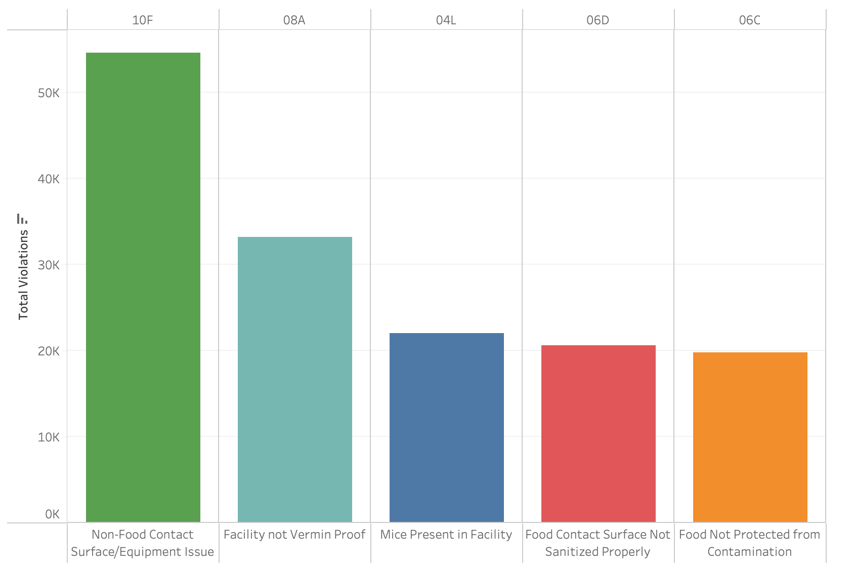
NYC Top 5 Restaurant Violations (by violation codes)
Non-Food Contact Surface/Equipment Issue: 54,521
Facility not Vermin Proof: 33,187
Mice Present in Facility: 21,966
Food Contact Surface Not Sanitized Properly:
20,576
Food Not Protected from Contamination:
19,784
Notes:
This visualization shows the top 5 restaurant violations in NYC. The first one relates to non-food-contact surfaces and equipment issues meaning surfaces aren’t made with materials that make cleaning easy, and certain equipment prevents restaurants from deep cleaning, leading to dirt or debris buildup that might result in an infestation. The second one is that the facility is not vermin-proof. Third, being mice present in the facility. The fourth being that the food contact surface was not properly sanitized, and lastly, the food was not protected from contamination.

Slide 14
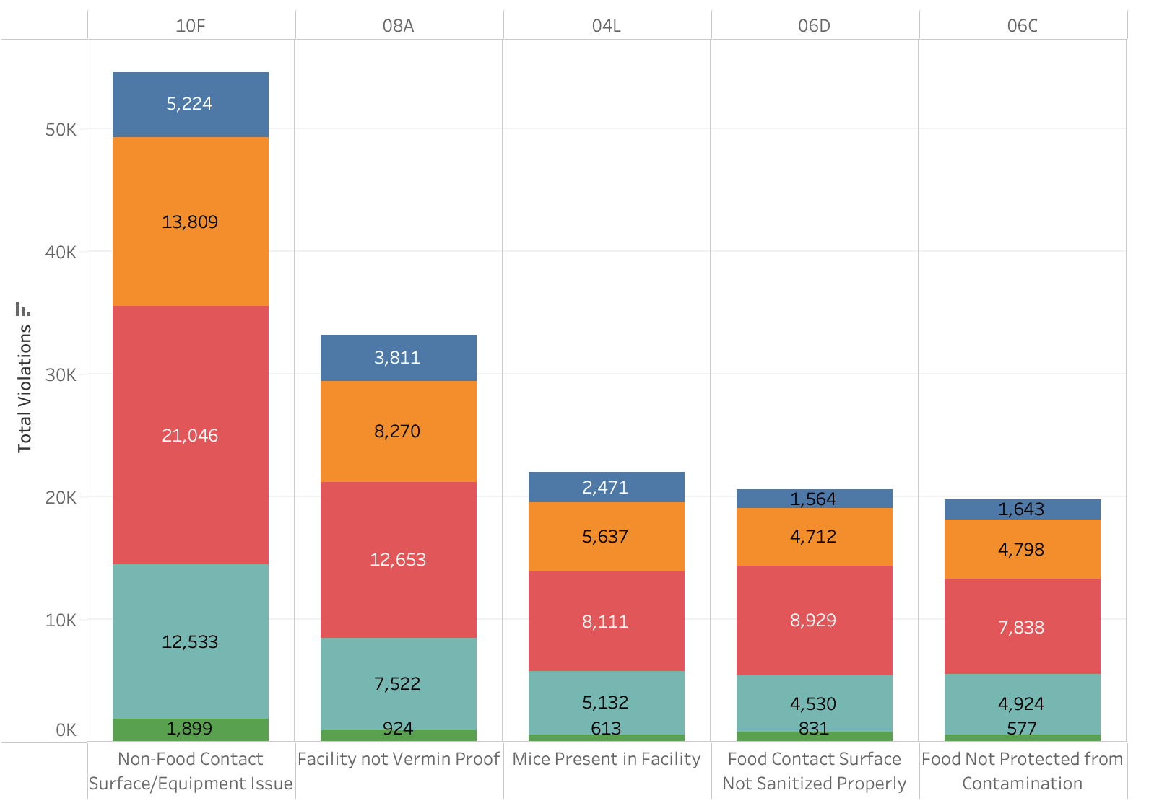
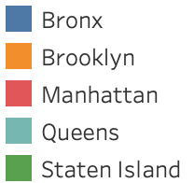
NYC Top 5 Restaurant Violations (by violation codes and borough)
Borough:
Notes:
Teresa- Top restaurant violations broken down by each borough. This further backs up Wesley’s visualization in which Manhattan is a top contender in each category.

Slide 15
How Different Zip Codes Compare

Slide 16
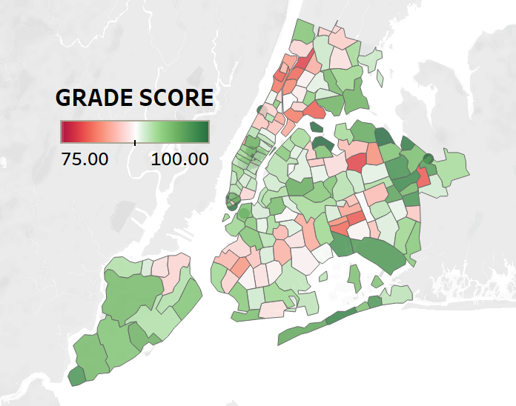
Grade Scores for Different Areas
Key Observations:
After certain inspection restaurants received a grade
Areas shade darker green are home to a majority of restaurants that hold A grade resulting from good inspection
Red Shade Area are home to a majority of restaurants that hold C grades
Notes:
nick

Slide 17
Are inspection cycles improving over time?
Notes:
Kat: Are inspection cycles improving over time?

Slide 18

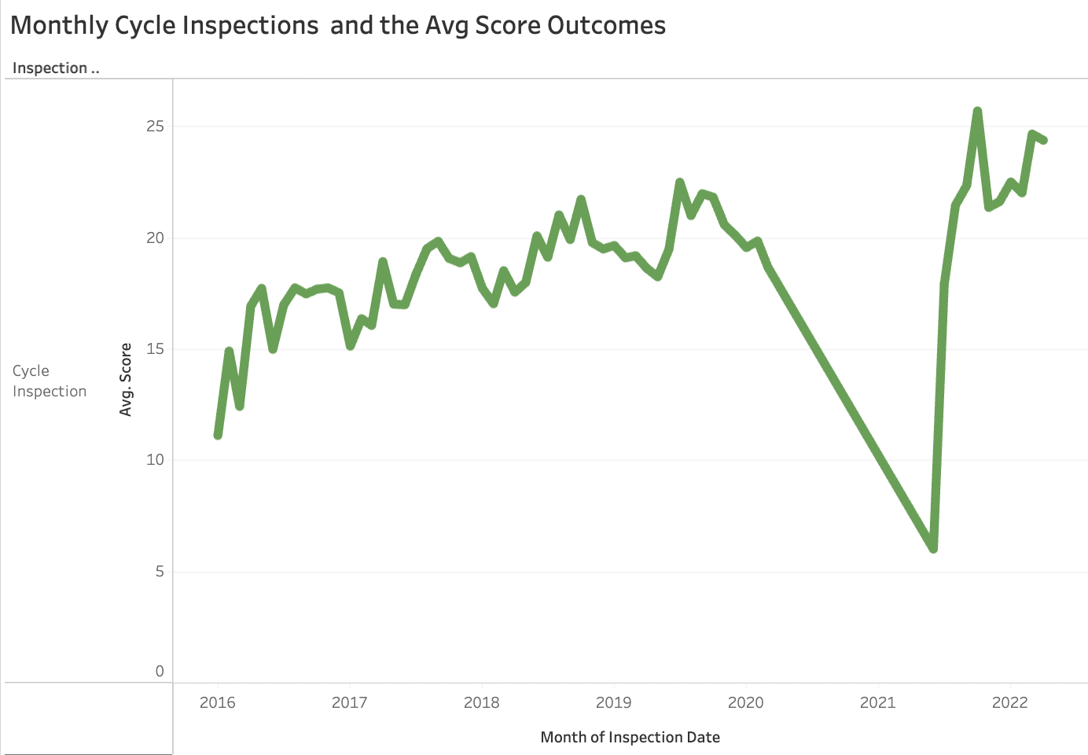
Monthly Cycle Inspections and the Avg Score Outcomes
Notes:
Key Observations
This graph looks at average score rather than grade score
During the pandemic there were NO inspections leading to no scores given out
Immediately after the pandemic the scores began to skyrocket
Then after a year it began to go down then average out into being consistently in the 20s post pandemic compared to pre pandemic where it was averaging in the teens and low 20s

Slide 19
Conclusion
Main Points
Recommendations
Specific areas have displayed higher concentration for violation – Manhattan being a prime example
Cleanliness is a main variable of violation
To continue protecting the people of New York is to have committee members advocate for the health and safety for them through sanitation and maintenance operations
Proportional allocation based on violation frequency
Mandate compliance programs
Notes:
Wesley
Main points: recurring violations bc of repeated behaviors like cleanliness
Recs:
Could divide resources such as inspectors based on violation frequency by area so more in manhattan and less in staten island for example
violations occur as a result of restaurant compliance over infrastructures so allocating more compliance programs (training courses) are advised

Slide 20
Call to Action
Pandemic
Investigate
Potential Solution
Post pandemic scores average higher
Culture shift around virus protection
Fund hygiene awareness programs
Area Differences
Potiental Causes
Needs for Support
Create Grants/Programs
Reinforce training
https://www.nyc.gov/site/fund/initiatives/restaurant-revitalization-program.page
Notes:
Pandemic: Kat
Post pandemic scores began to avg higher than pre pandemic so its recommended to invest more funds into programs that promote hygiene practices to keep the culture shift of awareness around virus protection
Investigate: Nicholas
Potential Solutions: Teresa
-Since the top violation falls under facility maintenance and is due to non-food surface not being easy to clean or equipment preventing restaurants from cleaning, we believe that by creating grants for restaurants in need of help to upgrade to new equipment or hire more staff, we can help improve restaurants and prevent them from getting more violations. This would also help restaurants in the red zip codes become green to improve scores. Examples of existing programs include Restaurant Strong and the Restaurant Revitalization Program. Another solution is to require all, or more, kitchen workers to hold a Food Protection Certificate. Right now, NYC only requires one supervisor to hold the certificate, but requiring more people to complete the training will increase awareness of cleanliness and proper hygiene in restaurants. Since the certificate requires money, there should be programs to help low-income individuals or those with a language barrier.

Slide 21
Thank you
Questions?
Notes:
Teresa

